Slide 1
Numerical Analysis
Introduction to MATLAB
Lab3

Slide 2
Objectives
To be able to understand the control structure in MATLAB
To be able to create MATLAB m-files
To understands the basics of MATLAB files

Slide 3
Polynomials
roots(p) | Find the roots of a polynomial whose coefficients are given in p
roots([1 4 2.1]) | Find the roots of x²+4x+2.1=0
polyval(p,v) | Evaluate the polynomial whose coefficients are given in p at x=v

Slide 4
Graphics on MATLAB
MATLAB produce 1, 2 and 3 dim plots of curves and surface
Simple 1D graphics Example
  Linear scales
2D graphics
3D graphics

Slide 5
Examples
plot() – draws a set of ordered pairs of points with or without lines. e.g. y=cos(x) and z=cos²(x) over interval [0,pi].
  >>x=0:0.1:pi; % specifies the domain
  >>y=cos(x); % define 1st function
  >>z=cos(x).^2; % define 2nd function
  >>plot(x,y,x,z,’o’) % display graph. (x, y 1st fun , x, y 2nd fun )
fplot() – draw curve of a one-dimensional function.
  fplot(“name’,[a,b],n) % plot name.m by sampling n points in interval [a,b]
>>fplot(‘tanh’,[-2,2]) % plots y=tanh(x) over [-2,2]
title(), xlabel(), ylabel() – commands for text in plot windows

Slide 6
Examples
time=[0:0.01:6]
Y=sin(time)
Generating data
Plot Y verses time x- axis is time
y- axis is Y
plot(time,Y)
xlabel('time')
ylabel('sin(time) ')
title(' plot of sin(time) ')
grid
Add a label to the x- axis
Add a label to the y- axis
Add a title
Add grid lines

Slide 7
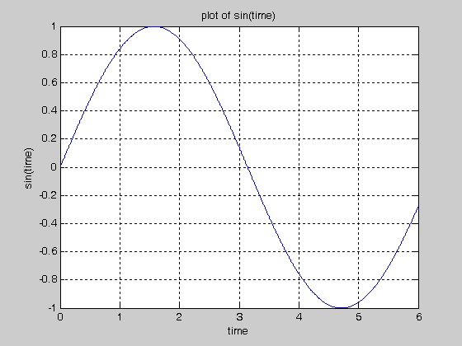

Slide 8
Examples
Ex. Plot x and y on graph
    >>x=linspace(0,1); % Row vector with 100 points
    >>y=x.^n.*exp(x); % Gives row vector
    >>plot(x,y,‘o') or >>plot(x, x.^n.*exp(x))
Ex. Plot ellipse c(t)=(2cos(t),3sin(t)), where 0<=t<=2pi
    >>t=0:0.2:2*pi;
    >>plot(2*cos(t),3*sin(t))
Ex. Plot curve c(t)=2cos(t),t²,1/t), where 0<=t<=4pi
    >>t=0:0.2:4*pi;
    >>plot3(2*cos(t),t.^2,1./t)

Slide 9
Programming in MATLAB
time=[0:0.01:6]
Y=sin(time)
Generating data
Plot Y verses time x- axis is time
y- axis is Y
plot(time,Y)
You can add
a label to the x- axis
a label to the x- axis
Title

Slide 10
Examples
time=[0:0.01:6]
Y=sin(time)
Generating data
Plot Y verses index x- axis is column #
y- axis is Y
plot(Y)
semilogx(time,Y)
Plot Y verses time
x- axis is time (log scale)
y- axis is Y (linear scale)
semilogy(time,Y)
Plot Y verses v
x- axis is v (linear scale)
y- axis is Y (log scale)
loglog(time,Y)
Plot Y verses v
x- axis is v (log scale)
y- axis is Y (log scale)
You can modify the scales directly on the figure Click Edit-→ axis properties

Slide 11
User Defined Function
Ex.
  function P=pasc(n,m)
  %Input - n is the number of rows
  %- m is the prime number
  %Output - P is Pascal’s triangle
  for j=1:n
    P(j,1)=1;P(1,j)=1;
  end
  for k=2:n
    for j=2:n
      P(k,j)=rem(P(k,j-1)+P(k-1,j),m);
    end
  end

Slide 12
Sub Functions
It is an other function is created in same file after the body of main function.
Sub function is visible to only other functions in the same file.
Subfunctions are not visible outside the file where they are defined.
    e.g. avg is a subfunction within the file stat.m:
  function [mean,stdev] = stat(x)
  n = length(x);
  mean = avg(x,n);
  stdev = sqrt(sum((x-avg(x,n)).^2)/n);
  % it is a sub function
  function mean = avg(x,n)
  mean = sum(x)/n;

Slide 13
Example
% generates a row vector of 100 linearly equally spaced points
x=linspace(0,1);
hold on % holds the current plot
for n=0:10 % Loop 0 to 10
y=x.^n.*exp(x); % * for Matrix and .* for Array
plot(x,y,'k') % k for block or b for blue
end % End of Loop

